Slide 1


Student Details
NAME :- Puppala Keerthinjai
ROLL NO :- AP22110010287
EMAIL ID :- keerthinjai_puppala@srmap.edu.in
BRANCH :- CSE
COLLEGE NAME :- SRM UNIVERSITY AP
INTERNSHIP DOMAIN :- EDUNET(DGT)
START DATE :- 06-06-2024
END DATE :- 25-07-2024

Slide 2
EMPLOYEE BURNOUT PREDICTION
PROBLEM STATEMENT
This study aims to contribute valuable insights into managing and mitigating employee burnout, ultimately fostering a healthier and more productive work environment.
Feel free to tailor this problem statement further to fit the specific context and objectives of your research or analysis on employee burnout.
STRESS OVERLOAD

Slide 3
AGENDA
This presentation outlines the key aspects of the employee burnout prediction project, covering the project overview, methodology, results, and potential applications.
1. Project Overview : Introduction to employee burnout and the project's goals.
2. Methodology : Description of the data used and the machine learning models employed.
3. Results : Presentation of the model's performance and key findings.
4. Applications : Discussion of potential applications for the developed model.

Slide 4
PROJECT OVERVIEW
Employee burnout is a state of emotional, physical, and mental exhaustion caused by prolonged or excessive stress. This project aims to develop a model that can predict employee burnout based on various factors such as workload, work-life balance, job satisfaction, and interpersonal relationships.
Problem Statement
Employee burnout is a significant issue impacting productivity and well-being.
Project Goal
To develop a predictive model for employee burnout.
Approach
Using machine learning techniques to analyze employee data.
Impact
Early intervention and targeted support for employees at risk of burnout.

Slide 5
WHO ARE THE END USERS of this project?
The end users of this project are those who can benefit from early identification and intervention related to employee burnout.
Human Resource Professionals: implement targeted interventions and develop proactive strategies.
Managers: To identify and support employees at risk of burnout within their teams.
Employees: To raise awareness of burnout, access resources, and promote self-care.
Executives and Senior Management: They can use aggregated data to make strategic decisions regarding company policies, work environment improvements, and overall organisational health strategies.
Occupational Health Professionals: They can utilise the tool to provide better support and intervention strategies for employees at risk of burnout.

Slide 6
YOUR SOLUTION AND ITS VALUE PROPOSITION
Solution Overview
Data Integration: Connects with HR and project management tools.
Predictive Modeling: Uses advanced analytics and machine learning.
Real-time Insights: Provides continuous monitoring and updates.
Personalized Interventions: Tailored strategies to mitigate burnout.
Value Proposition
Cost Savings: Reduced turnover and lower healthcare costs.
Compliance and Reporting: Ensures regulatory compliance and provides detailed analytics.
Employee Engagement and Morale: Increased engagement and a positive workplace culture.

Slide 7
How did you customize the project and make it your own
This project was customized to predict student burnout, considering factors specific to the student population such as academic workload, social pressures, and financial constraints.
I customized the project by focusing on the unique aspects of the provided data, such as incorporating specific features like work-from-home setup availability and mental fatigue scores.
I employed a comprehensive data preprocessing approach to handle missing values, normalize data, and encode categorical variables, ensuring the model's accuracy and robustness.
Additionally, I selected and tuned predictive models like logistic regression and random forest to capture both linear and non-linear relationships in the data.
By integrating these models into a user-friendly dashboard, I made it accessible for HR and management to make informed decisions

Slide 8
MODELLING
STEP-1 : DOWNLOAD DATA SHEET
STEP-2 : GO TO GOOGLE AND SEARCH COLAB
STEP-3 : CLICK NEW NOTEBOOK AND UPLOAD DATA SHEET
STEP-4 : RUN CODINGS SUCH AS PANDAS,READ,INFO,DESCRIBE..ETC
STEP-5 : SAVE
STEP-6 : COPY LINK THROUGH DRIVE.
STEP -7 : SHARE LINK IN PPT

Slide 9
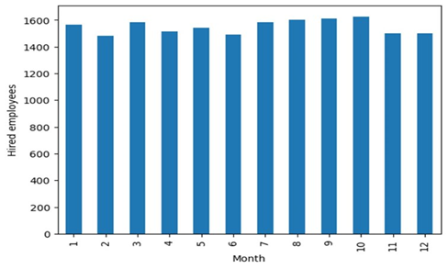
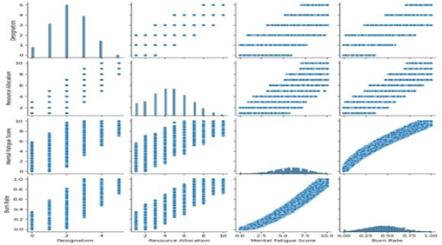
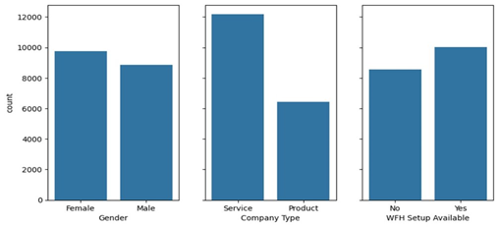
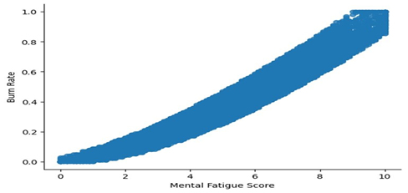
Results
The developed model achieved a high level of accuracy in predicting employee burnout. The results highlighted key factors contributing to burnout, providing valuable insights for intervention strategies.

Slide 10
links

